Slide 1
Educational Solution Policy Brief
Zanzibar Blue Economy Policy Recommendation
Notes:
Esther

Slide 2
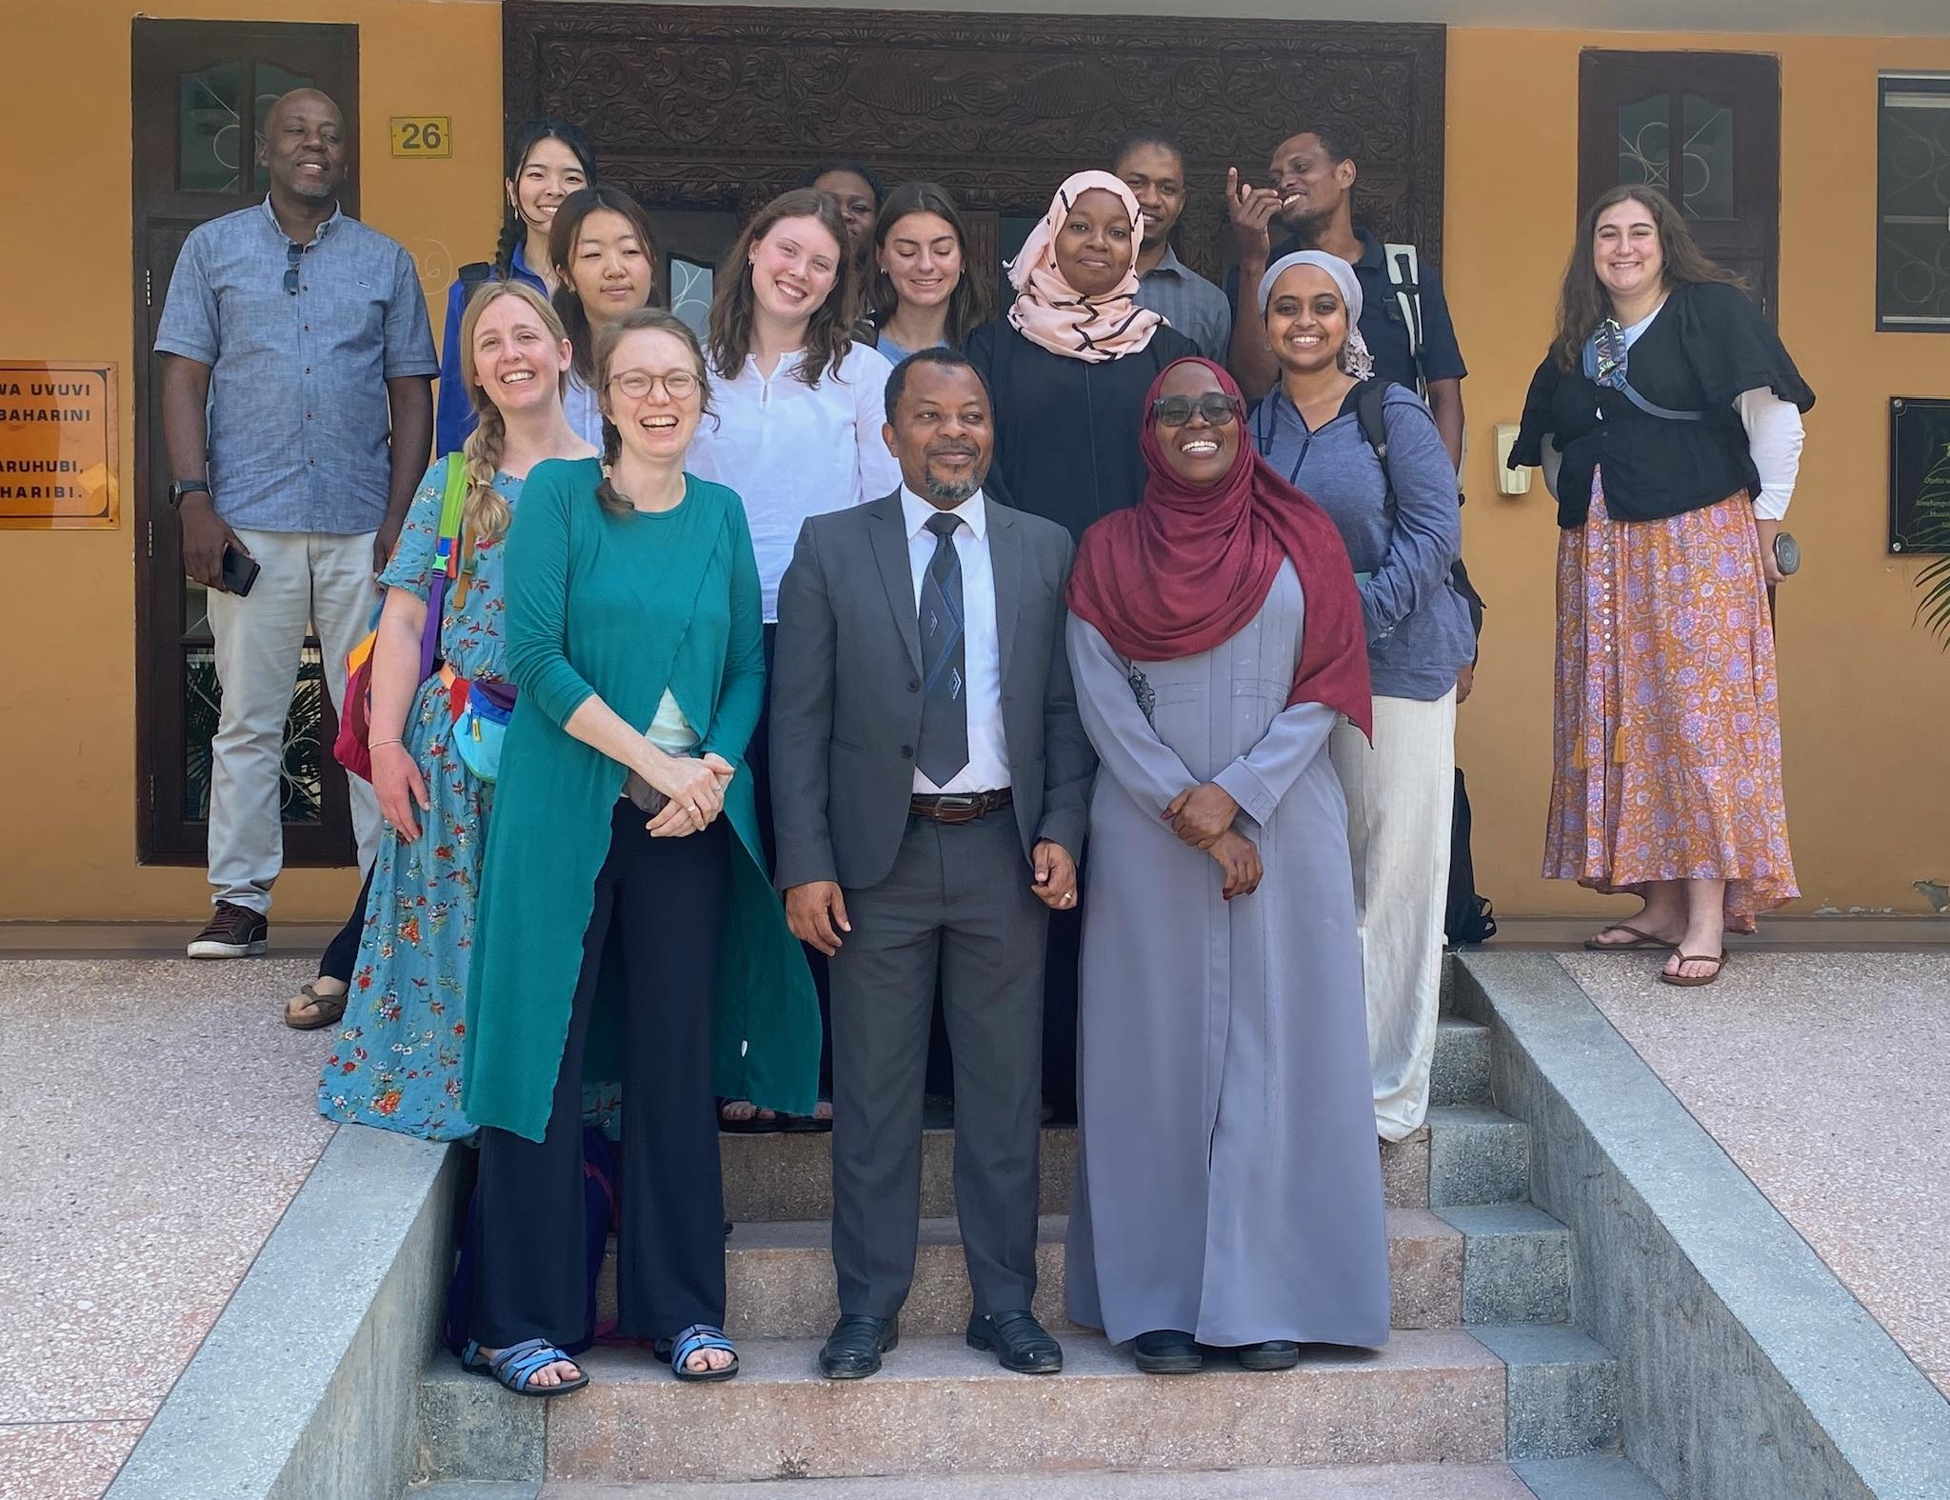
Habari!
Presented By: Esther Kang, Julia Wowkun, Temilade Onile
Collaborators: Dr. Caitlyn Bolton, Kaley McCarty, Dr. Mary Khatib, Cara Williams, Mia Cresti, Saron Yared, Annabel Lee, Laura Steinberg
Boston College Schiller Institute Working For and With Communities Course
Notes:
Esther

Slide 3
Statement of Issue
Zanzibaris have low involvement in or are excluded from the tourism sector
Locals do not see the benefits of tourism, such as increased job opportunities
Barriers preventing local involvement in tourism, tourism industry’s use of local resources, and tourists’ lack of cultural awareness creates tension between stakeholders
Notes:
Temi
While tourism is one of the biggest contributors to the development of Zanzibar’s economy, Zanzibaris’ involvement in this sector is relatively low. Often, foreign investors are the ones to build hotels and attract or bring other expats with them to create successful businesses. When this happens, locals are excluded from the benefits of a prosperous tourism industry such as increased job opportunities. Tourism’s use of local resources coupled with barriers that prevent local involvement in the industry creates tension within communities. Locals also tend to resent tourists because of their lack of cultural awareness. This tension is also primarily due to a lack of communication, understanding, and difficulties in accessing resources. Education is a crucial method of creating synergy between stakeholders and increasing access to the benefits of tourism to locals.

Slide 4
Potential Benefits of Education
Establishing connections and improving relationships between stakeholders
Assisting locals in better advertising their brand
Empowering locals to make informed financial decisions
Guiding Zanzibaris in navigating competitive landscapes
Mitigate local-tourist tensions by providing accessible and invitational materials for tourists to learn about local culture
Notes:
Julia

Slide 5
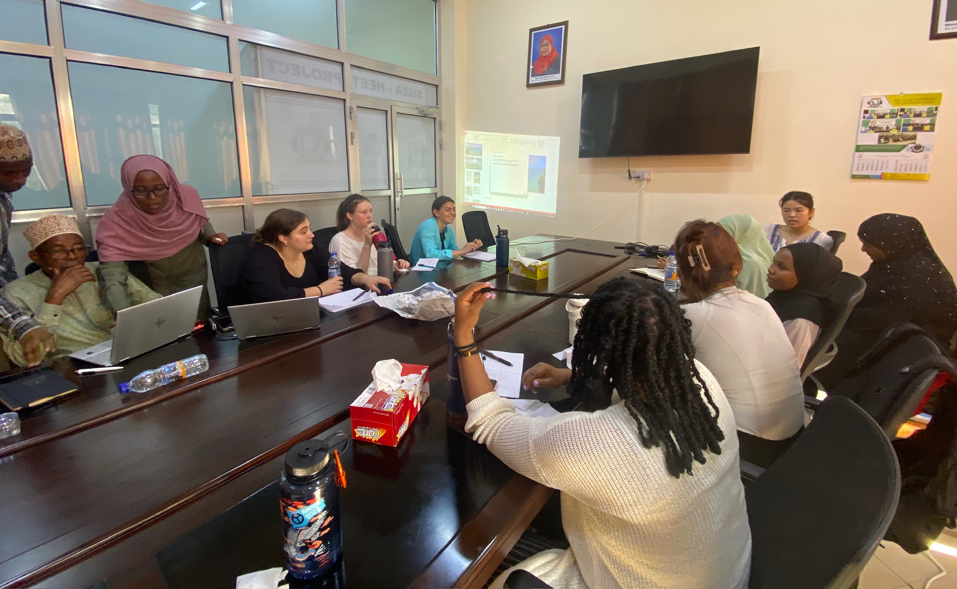
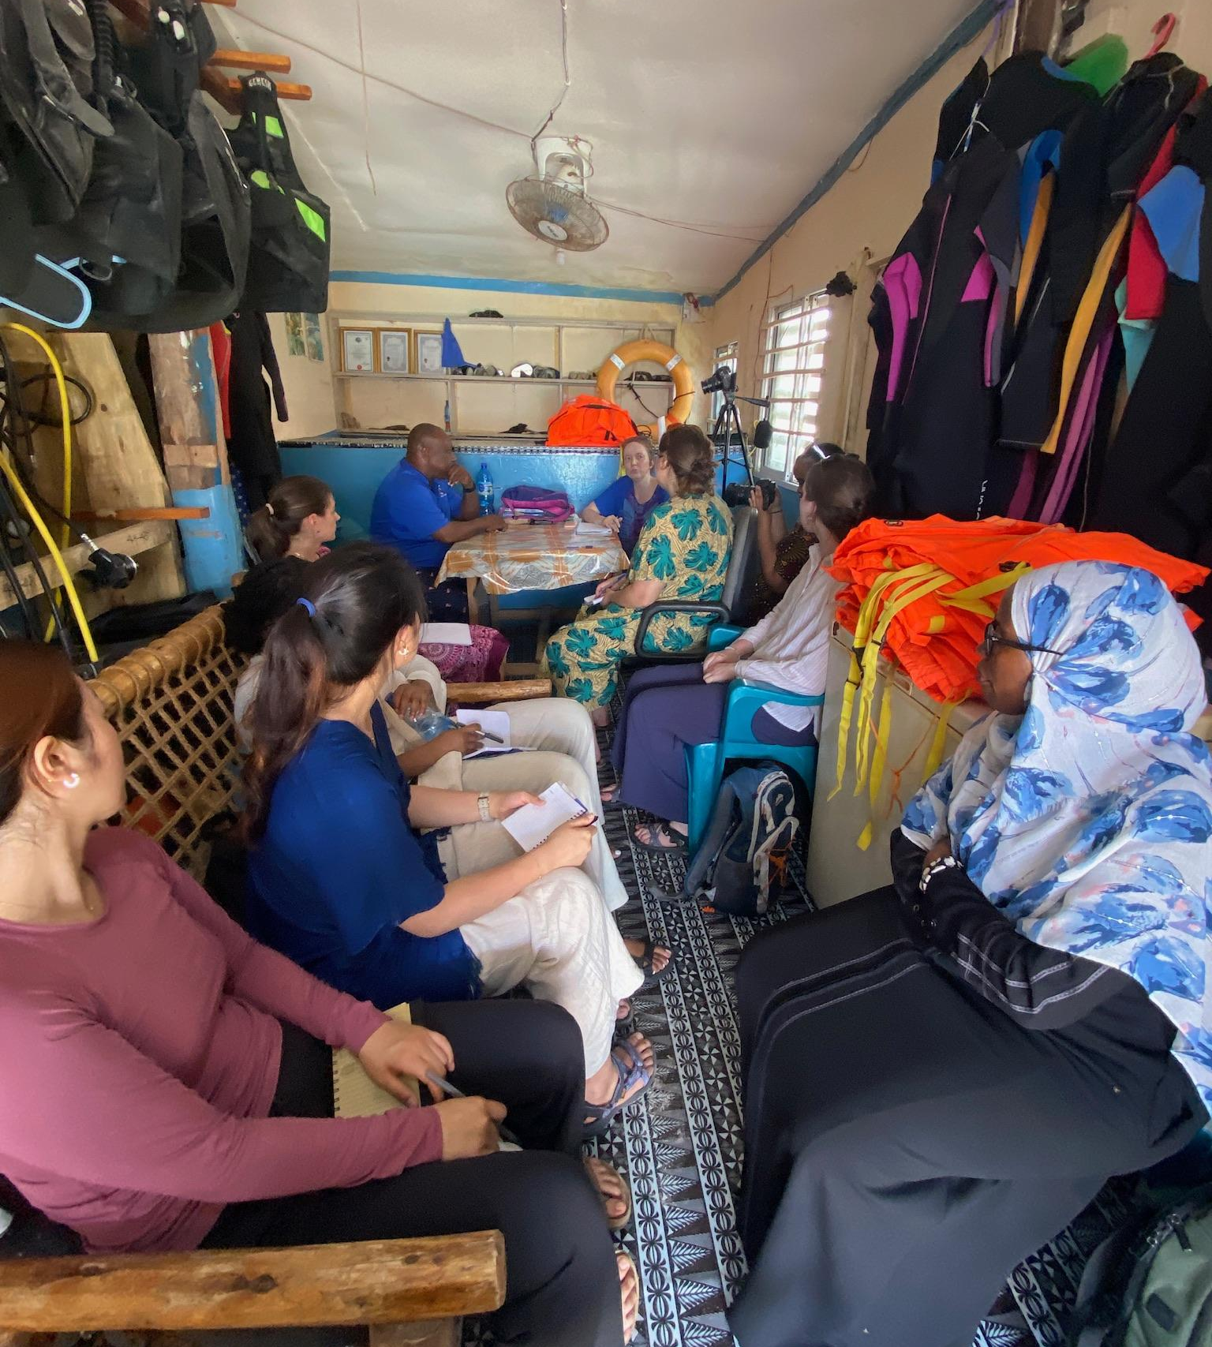
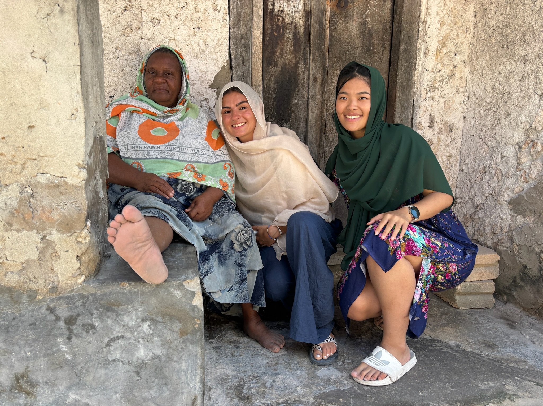
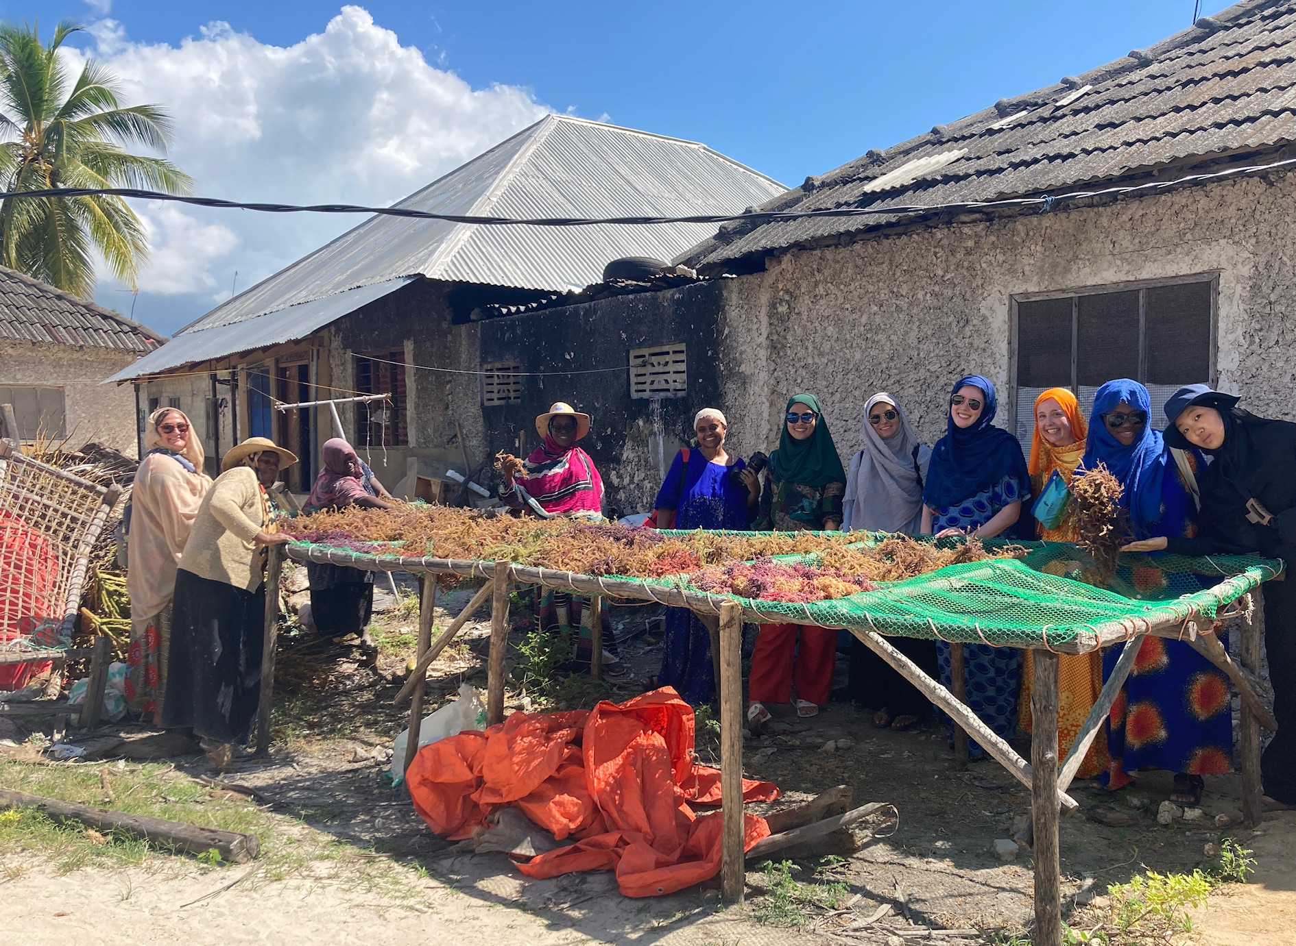
Background &
Key Data

Slide 6
Background & Key Data
“60.6 percent of tourism activities in Zanzibar are said to be done by foreigners…”(Mikofu 2024)
Those who do not have access to education face greater barriers for entry in the tourism sector
“People from the mainland possess the educational background, the linguistic skills and the willingness to work in tourism, in contrast to Zanzibaris, who often have lower education and are less qualified.” (Keshodkar, 2013)
Complex nature of laws around land right of use place local Zanzibaris in a disadvantaged position vis-a-vis more informed foreign investors.
Notes:
Esther
Asq Temi mentioned in the Statement of Issue, Zanzibaris have low involvement in tourism industry: Article published on mwananchi(mo-nanchi) by Jesse Mikofu “60.6 percent of tourism activities in Zanzibar are said to be done by foreigners…”(Mikofu 2024)
This issue can be attributed to the lack of access to education:
Keshodkar, in his book, Tourism and Social Change in Post-Socialist Zanzibar, talks about the struggles Zanzibaris face when trying to become involved in tourism: “People from the mainland possess the educational background, the linguistic skills and the willingness to work in tourism, in contrast to Zanzibaris, who often have lower education and are less qualified.”
Another issues that puts zanzibaris at disadvantage has to do with One of the key factors in developing wealth: ownership of land.
Less than 15% of homeowners in Zanzibar possess official records that prove legal ownership of a property
While there has been effort to improve the lack of land right such as The Ministry of Lands, Energy and Water in collaboration with the Spatial Collective conducting a pilot project of measuring/documenting the land (Cities Alliance) to try and rectify the lack of title deeds.
On the other hand, the complex nature of laws and regulations around land right of use, including establishment of the Right of Occupancy, negotiating lease agreements, and creating shared-profits arrangements, places local Zanzibaris in a disadvantaged position compared to informed foreign investors.

Slide 7
Background & Key Data - Interviews
Solomon, a local tour guide was able to learn many languages and build a successful business
A masseuse felt a lack of support in terms of training for business management and advertising to compete with the hotels
Notes:
Temi
Interviews that we conducted with the local population revealed concerns regarding the unfair nature of the competition:
A masseuse whose client base is mainly tourists and who initially partook in seaweed farming shared resentment of the lack of support in terms of training for business management and advertising to properly compete with the hotels. It is particularly important to support such small business operations given the difficulty for Zanzibaris to find direct employment within the hotels.
A local tour guide described the value of knowing different languages. He has been successful because he has been able to learn various languages such as English, French, and Italian, so he can communicate with tourists and build his business. However, those who do not have access to education to learn languages or basic financial literacy face greater barriers when trying to get involved in the tourism industry.

Slide 8
In light of our findings above, we recommend the development and implementation of short education modules that assist Zanzibaris in gaining a competitive advantage and getting involved in the tourism industry, on:
1) Social Media and Marketing Literacy
2) Negotiations and Financial Literacy
3) Cultural Orientation for Tourists.
Notes:
Julia

Slide 9
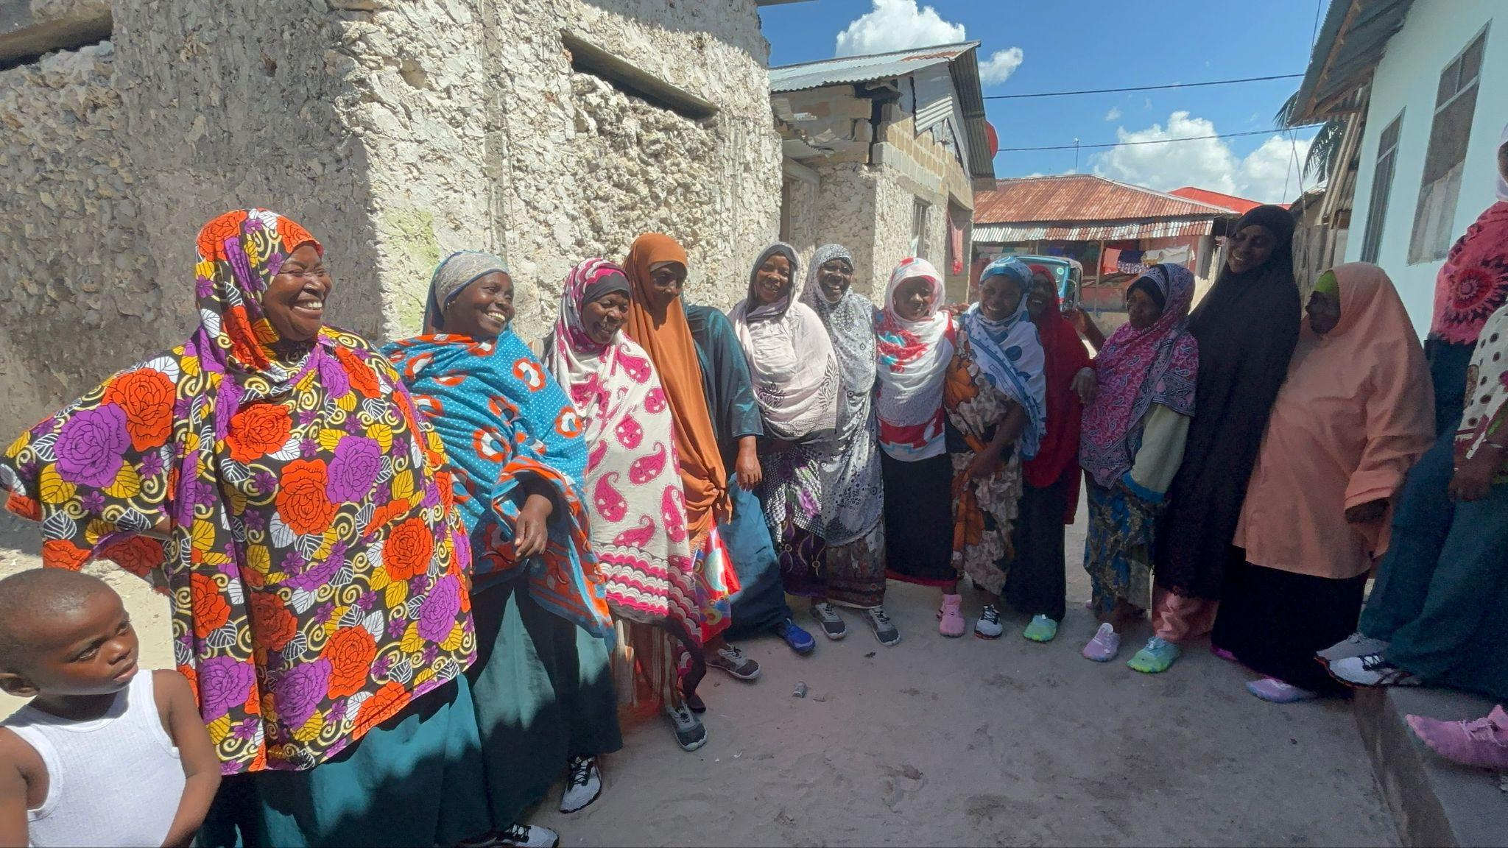
Social Media and Marketing Literacy
Help tourists discover locally-owned businesses
Many tourists plan their trips online, but are unaware of most local businesses
Helping to promote local businesses will increase visibility and help them grow
Create a comprehensive curriculum with accompanying workbook on social media and marketing in an accessible format
Notes:
Esther
Formulation of a curriculum on social media and marketing would benefit both Zanzibari business owners and tourists.
Most locally-owned businesses remain small in Zanzibar, while tourists have a limited way of knowing places to visit beyond well-known travel destinations.
Many tourists plan their trips online which creates challenges against the hyper-localized nature of Zanzibar businesses: people are unable to learn about local business and foreigners who have made their businesses more accessible and available for tourists are monopolize the industry.
Considering the conditions and culture of Zanzibar, it would be most effective to create a comprehensive and manageable curriculum with an accompanying workbook on marketing in an accessible format. We imagine that more tech-savvy young people might systematically support older generations’ engagement in the curriculum.

Slide 10
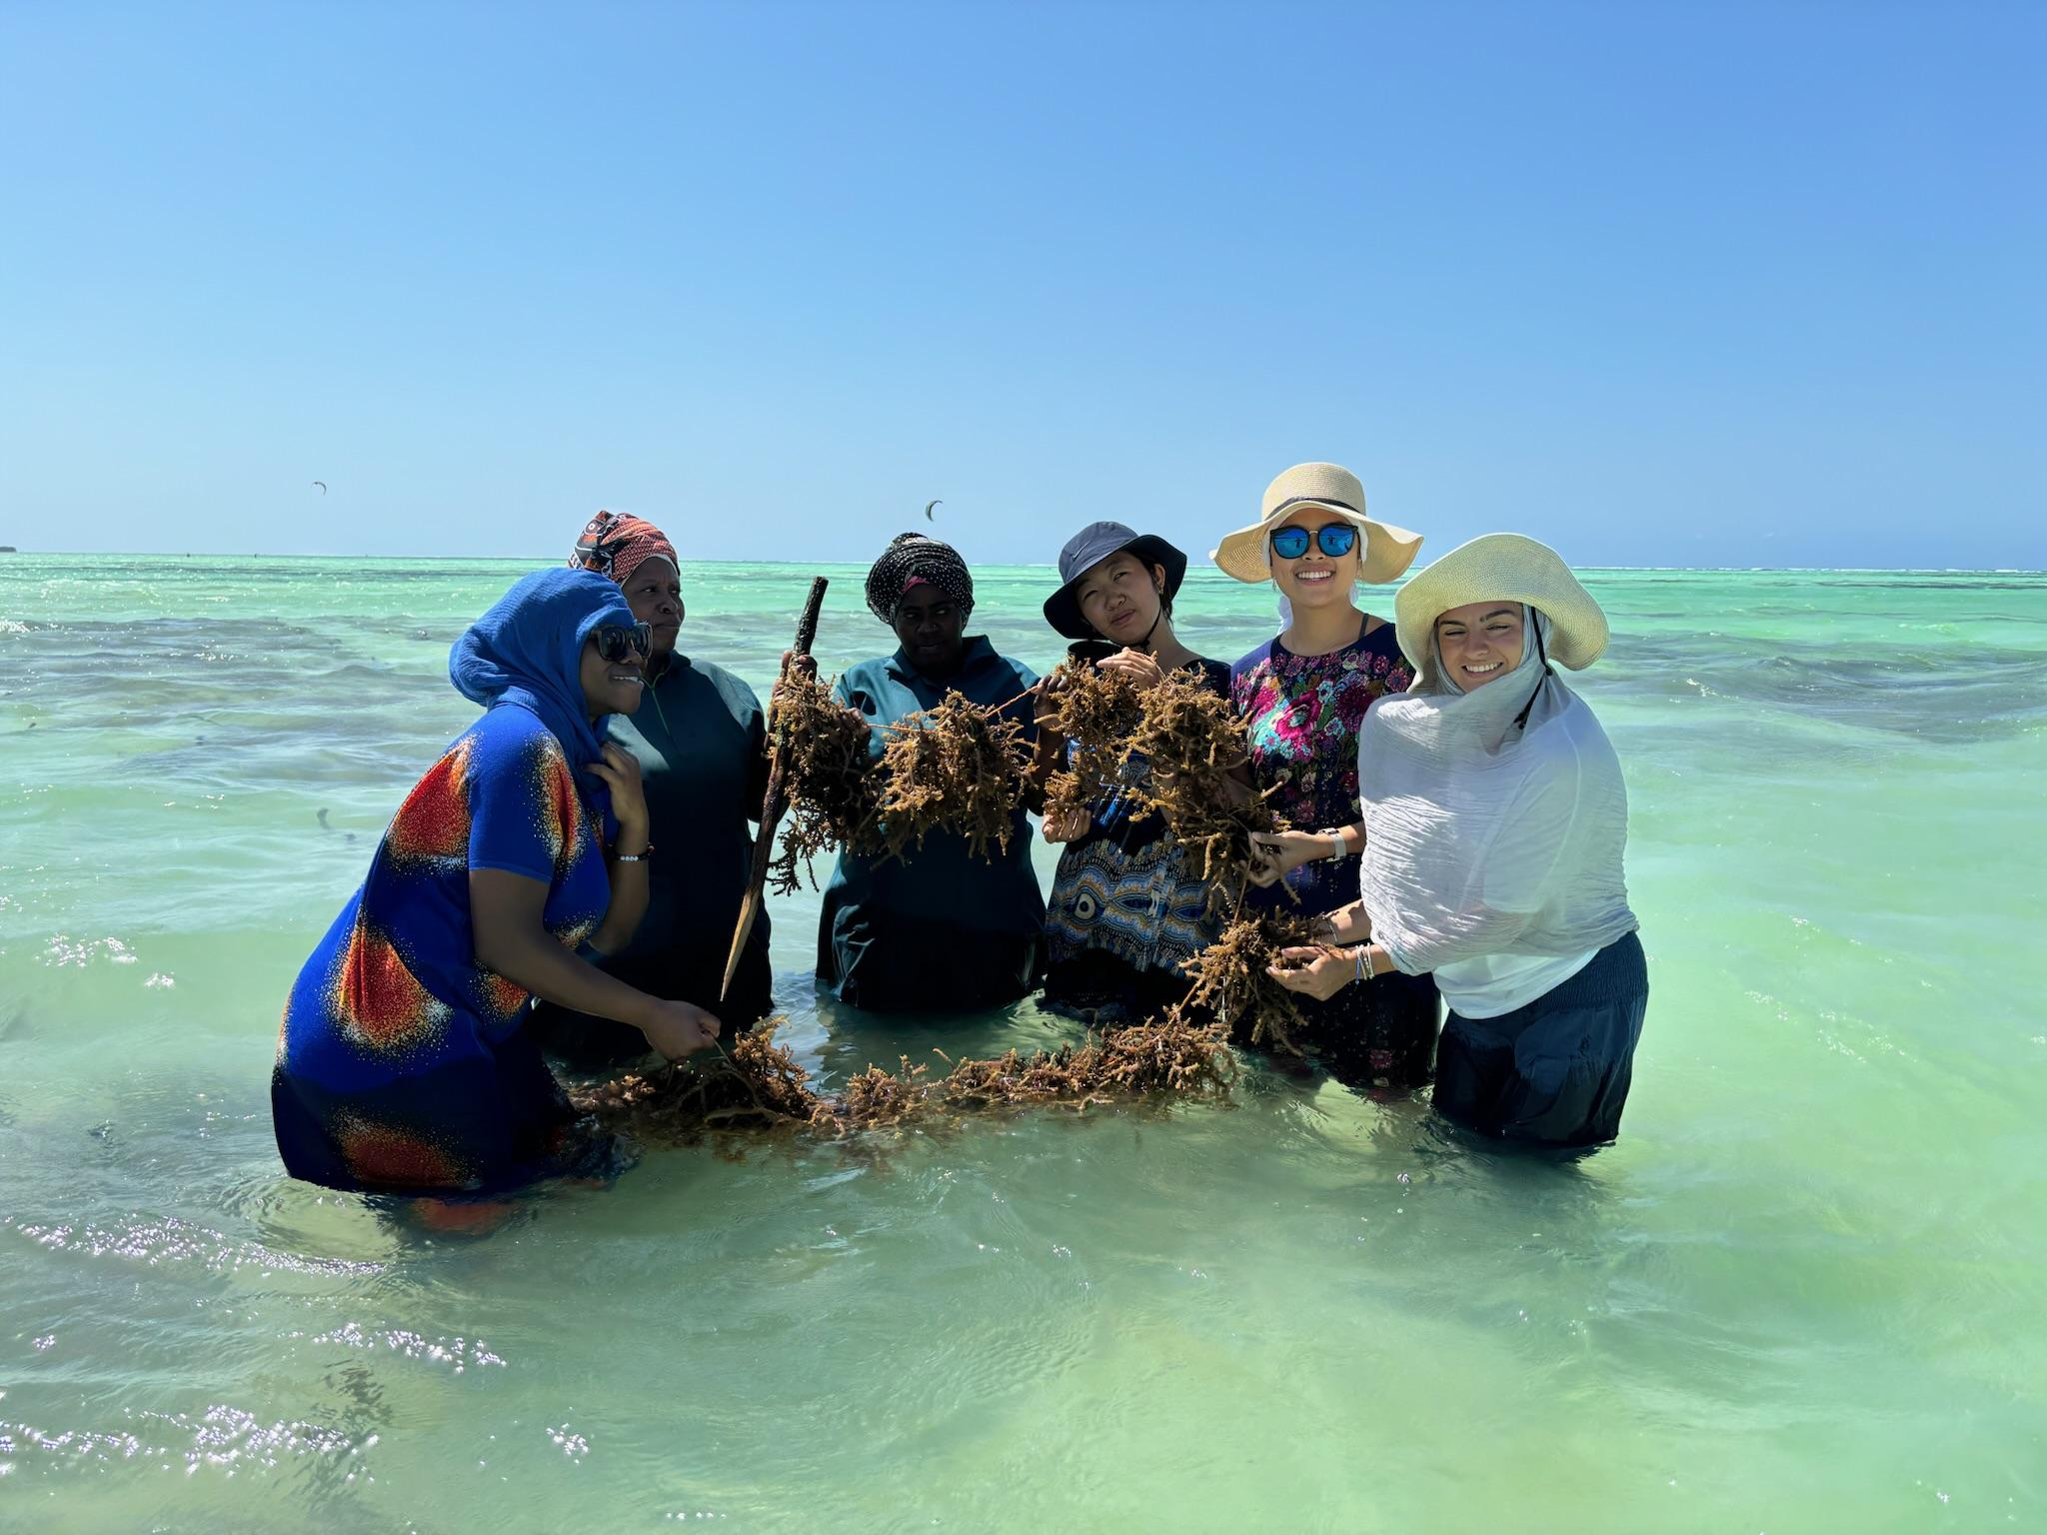
OPPORTUNITIES
CHALLENGES
;;
Lack of access to internet technologies which will allow the Zanzibaris to put their new technological literacy into practice.
It may also be difficult to generate motivation and sustained interest in internet marketing in older generations
Increase the potential for fair and effective competition in the market
Allow local entrepreneurs to attract tourists who plan their trips on social media and the internet.
Increase the opportunities for intergenerational collaboration in support for traditional and local businesses
Accessible workbook will allow people to learn at their own pace at any time, without requiring a burdensome time and financial commitment.
Notes:
Opportunities: Social media literacy would increase the potential for fair and effective competition in the market, allowing local entrepreneurs to attract tourists who plan their trips on social media and the internet. It would also increase the opportunities for intergenerational collaboration in support for traditional and local businesses. Having a workbook will also allow people to learn at their own pace at any time, without requiring a burdensome time and financial commitment.
Challenges: A key challenge is the lack of access to smartphones and other internet technologies which will allow the Zanzibaris to put their new technological literacy into practice. Particularly with older generations, it may also be difficult to generate motivation and sustained interest in internet marketing.

Slide 11
Negotiations and Financial Literacy
Support Zanzibaris to be better positioned to benefit from new tourist investment
Cover the key laws and regulations regarding selling landed property, skills for negotiations, and financial principles related to profit-sharing and smart investment
Expand on earlier initiatives to document land ownership and title deeds
Provide newly recognized deed owners with education on how to make responsible investment decisions including learning the value of properties
Notes:
Temi
Negotiations and Financial Literacy
An educational module on negotiations and financial literacy would serve to support Zanzibaris living in newly-developing tourist villages to be better positioned to benefit from new tourist investment. Such an educational module would cover the key laws and regulations regarding selling landed property, skills for negotiations, and financial principles related to profit-sharing and smart investment. This would expand on earlier initiatives to document land ownership and title deeds to provide newly recognized deed owners with education on how to make responsible investment decisions including learning the value of properties.
Opportunities: Mitigate the inequalities already experienced in highly developed tourist villages in Zanzibar by equipping Zanzibaris with the financial and legal knowledge to effectively negotiate with foreign investors and therefore better benefit in the long term from tourist investment. Bolster Zanzibaris’ capacity for economic growth through avenues such as loans, small business operations, and personal financial literacy and give Zanzibaris a competitive advantage in personal and corporate wealth by providing knowledge on how to make responsible investment decisions.
Challenges: The complexity of laws and regulations related to the sale of landed property and right of use in Zanzibar will make it difficult to create an educational module that is both comprehensive and accessible to those with varying educational backgrounds. Further, for some individuals there may be challenges in conveying the benefits of long-term investment over the short-term gain of immediate sale, and so the educational module should begin by ensuring the understanding and benefits of long-term investment.

Slide 12
OPPORTUNITIES
CHALLENGES
;;
Difficult to create an accessible module considering varying educational backgrounds and complexity of laws related to the sale of landed property and right of use
Conveying the benefits of long-term investment over the short-term gain of immediate sale
Educational module should begin by ensuring the understanding and benefits of long-term investment
Mitigate the inequalities already experienced in highly developed tourist villages
Equip Zanzibaris with the financial and legal knowledge to effectively negotiate with foreign investors
Bolster Zanzibaris’ capacity for economic growth through avenues such as loans, small business operations, and personal financial literacy
Give Zanzibaris a competitive advantage in personal and corporate wealth
Provide knowledge on how to make responsible investment decisions.
Notes:
Opportunities: Mitigate the inequalities already experienced in highly developed tourist villages in Zanzibar by equipping Zanzibaris with the financial and legal knowledge to effectively negotiate with foreign investors and therefore better benefit in the long term from tourist investment. Bolster Zanzibaris’ capacity for economic growth through avenues such as loans, small business operations, and personal financial literacy and give Zanzibaris a competitive advantage in personal and corporate wealth by providing knowledge on how to make responsible investment decisions.
Challenges: The complexity of laws and regulations related to the sale of landed property and right of use in Zanzibar will make it difficult to create an educational module that is both comprehensive and accessible to those with varying educational backgrounds. Further, for some individuals there may be challenges in conveying the benefits of long-term investment over the short-term gain of immediate sale, and so the educational module should begin by ensuring the understanding and benefits of long-term investment.

Slide 13
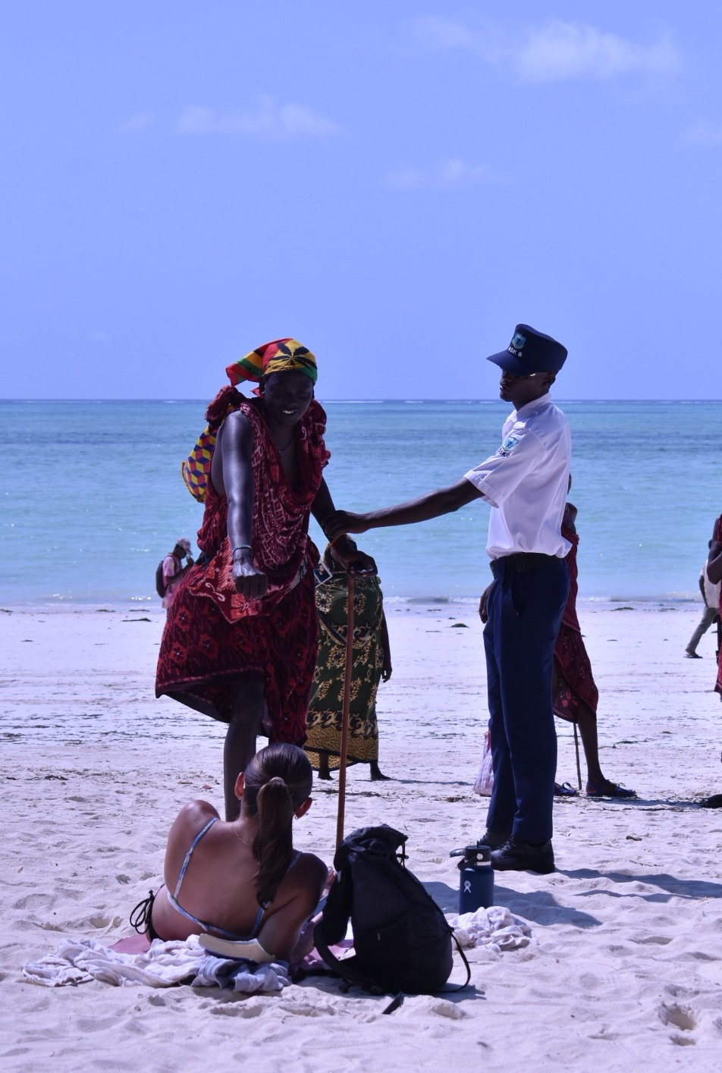
Educating Tourists
Create easily accessible information for tourists to address the tensions that arise from cultural differences
Information presented can involve local values, beliefs, the type of wardrobe appropriate in various places on the island, basic Swahili phrasing, Islamic prayer rituals, the importance of seaweed farmers and fishers, etc.
Materials should be invitational and light-hearted rather than didactic and preacherly
Module will necessarily involve multiple formats, both online and physical, before and during a tourist’s visit to Zanzibar
Notes:
Educating tourists - julia
The purpose of this educational initiative is to create easily accessible information for tourists to address the tensions that arise from cultural differences between tourists and locals. Information presented can involve local values, beliefs, the type of wardrobe appropriate in various places on the island, basic Swahili phrasing, Islamic prayer rituals, the importance of seaweed farmers and fishers, and other important topics. The tone of the materials should be invitational and light-hearted rather than didactic and preacherly, so that tourists feel that they are being welcomed into local culture rather than lectured to. This educational module will necessarily involve multiple formats, both online and physical, before and during a tourist’s visit to Zanzibar. We imagine the following components of the educational module:

Slide 14
Educating Tourists
Some components may include:
A short, welcoming video that introduces visitors to key aspects of the islands while mentioning cultural etiquette related to different spaces, including wearing more modest clothing
Posted on official websites linked to tourist travel in Zanzibar including the Zanzibar Commission for Tourism site, and if possible, can be played in the airport while visitors wait for their visas.
Attractive informational graphics at the entrances to beaches, on the doors of local restaurants and shops, and anywhere the local community sees fit
Inform tourists on how they can best respect the local culture and community.
Materials in hotels for their guests to look through to become acquainted with local cultural norms. This would ideally be created with the input of willing hotel management to ensure that the style and tone are appropriate for that setting, and to secure the buy-in of hotel leadership.
Notes:
Educating tourists - julia
A short and welcoming video that introduces visitors to key aspects of the islands while mentioning cultural etiquette related to different spaces, including wearing more modest clothing while not on the beach or while interacting with Zanzibaris engaged in coastal livelihoods on the beach. This video can be posted on official websites linked to tourist travel in Zanzibar including the Zanzibar Commission for Tourism site, and if infrastructure allows, can be played in the airport while visitors wait for their visas.
Attractive informational graphics can be created and replicated at the entrances to beaches, on the doors of local restaurants and shops, and anywhere the local community sees fit to help inform tourists on how they can best respect the local culture and community.
Materials can be developed to be made available in hotels for their guests to look through in order to become acquainted with local cultural norms. This would ideally be created with the input of willing hotel management to ensure that the style and tone are appropriate for that setting, and to secure the buy-in of hotel leadership.

Slide 15
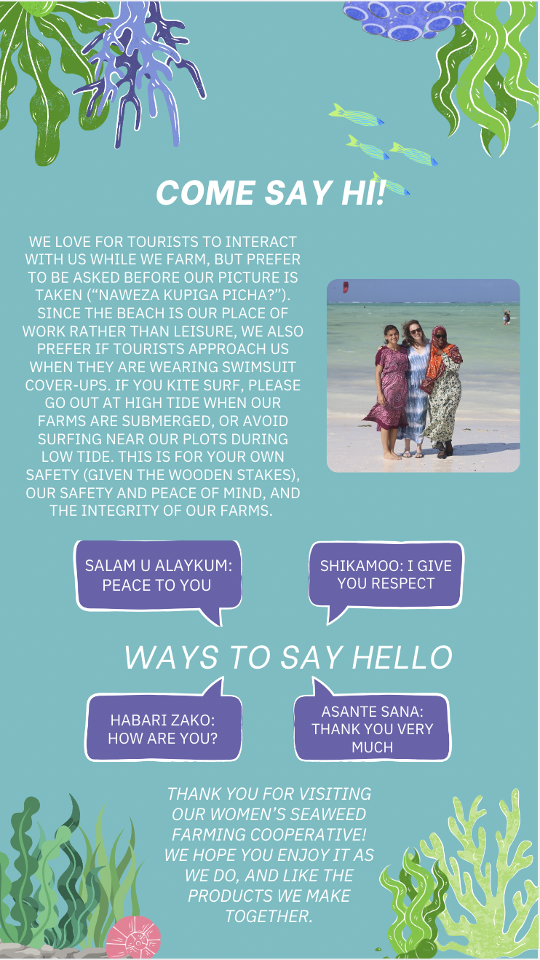
OPPORTUNITIES
CHALLENGES
;;
Tourists may feel imposed upon and resent the efforts to curb their behavior of the tone of materials is not invitational and light-hearted
Working with non-Zanzibaris to workshop the materials is thus vital to ensuring that the materials feel welcoming to outsiders
Tourists may also choose to ignore the information presented if they do not want to participate in creating an overall respectful environment.
Reduce tensions between locals and tourists by helping to inform tourists on how to respect local culture
Tourists can understand the importance of wearing appropriate clothing when they are in villages or not on a beach
Connecting with the community in this way will enrich the experience of the tourists
Notes:
julia
Opportunities: Making information on how to respect the local culture accessible to tourists is a critical way to reduce tensions between locals and tourists. Tourists can understand the importance of wearing appropriate clothing when they are in villages or not in a beach area. Connecting with the community in this way will enrich the experience of the tourists.
Challenges: If the tone of the materials is not invitational and light-hearted, tourists may feel imposed upon and resent the efforts to curb their behavior. Working with non-Zanzibaris to workshop the materials is thus vital to ensuring that the materials feel welcoming to outsiders. Tourists may also choose to ignore the information presented if they do not want to participate in creating an overall respectful environment.

Slide 16
Intended Outcomes:
Intergenerational communication and connection, encouraging tech-savvy youth to help support older generations in using technology and social media to promote their businesses
Empower communities, through increased financial, social media, and marketing literacy and better understanding the value of their properties
Increase market diversification by offering opportunities for locals to capitalize on opportunities generated by increased tourism
Mitigating intercultural tensions between tourists and Zanzibaris, through encouraging tourists to better understand and exhibit respect for local Zanzibari culture
Notes:
Esther - Intended Outcomes
Intergenerational communication and connection, encouraging tech-savvy youth to help support older generations in using technology and social media to promote their businesses
Empower communities, through increased financial, social media, and marketing literacy and better understanding the value of their properties
Increase market diversification by offering opportunities for locals to capitalize on opportunities generated by increased tourism
Mitigating intercultural tensions between tourists and Zanzibaris, through encouraging tourists to better understand and exhibit respect for local Zanzibari culture

Slide 17
We would love to hear your thoughts!
Asante Sana!
Thank you so much for sharing your time and resources with us!
We would love to answer any questions, hear your thoughts, and understand how we can further assist you in your goals!

Slide 18
Appendix
This data was collected by a group of seven students, one staff member, and one professor, all from Boston College. After a semester of study and preparation, our group spent three weeks in Zanzibar conducting ethnographic research to gather information on how economic and environmental change has impacted the coastal livelihoods in Zanzibar. Our research allowed us to form connections with stakeholders around the island including government officials and agencies, business owners, employees, investors, native-born community members, and immigrants who have moved to Zanzibar to pursue opportunities in the tourism sector commonly referred to as foreigners. While our perspective and inherent biases as foreigners lends an incomplete picture of Zanzibar’s complexities, we intend for our research to draw on our outside lens to help construct an objective understanding of the changes occurring in Zanzibar.
Notes:
Appendix:
This data was collected by a group of seven students, one staff member, and one professor, all from Boston College. After a semester of study and preparation, our group spent three weeks in Zanzibar conducting ethnographic research to gather information on how economic and environmental change has impacted the coastal livelihoods in Zanzibar. Our research allowed us to form connections with stakeholders around the island including government officials and agencies, business owners, employees, investors, native-born community members, and immigrants who have moved to Zanzibar to pursue opportunities in the tourism sector commonly referred to as foreigners. While our perspective and inherent biases as foreigners lends an incomplete picture of Zanzibar’s complexities, we intend for our research to draw on our outside lens to help construct an objective understanding of the changes occurring in Zanzibar.

Slide 19
Sources
Sources:
Keshodkar, Akbar. Tourism and Social Change in Post-Socialist Zanzibar. Lexington Books, 2013.
Mikofu, Jesse. “If the Natives Do Not Change, They Will Continue to Complain -SMZ.” Zanzibar, 28 Aug. 2024, https://www-mwananchi-co-tz.translate.goog/mw/zanzibar/wazawa-wasipobadilika-wataendelea-kulalamika-smz-4742552?_x_tr_sl=sw&_x_tr_tl=en&_x_tr_hl=en&_x_tr_pto=wapp.
Secure tenure on Zanzibar. Cities Alliance. (n.d.). https://www.citiesalliance.org/secure-tenure-zanzibar

