Slide 1
Prioritizing Local Governance
Zanzibar Blue Economy Policy Brief

Slide 2
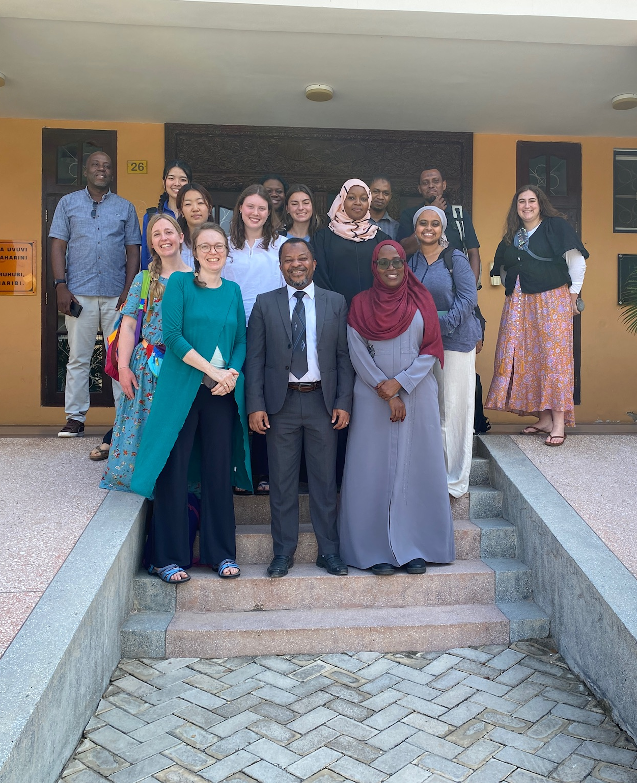
Habari!
Presented by: Mia Cresti and Cara Williams
Collaborators: Dr. Caitlyn Bolton, Esther Kang, Dr. Mary Khatib, Annabel Lee, Kaley McCarty, Temilade Onile, Dr. Laura Steinberg, Julia Wowkun, Saron Yared
Boston College Schiller Institute Working For and With Communities Course
Notes:
By way of reintroduction…

Slide 3
1
Statement of Issue
Notes:
Cara

Slide 4
Statement of Issue
Rapid growth of tourism in Zanzibar
  Blue Economy Ministry created in 2020 to respond to social & environmental concerns
Local tensions generated by rapid social, economic, and cultural change may hinder implementation of BEM programs
Expanding existing local governance structures in Zanzibar could facilitate successful implementation of the Blue Economy Policy

Slide 5
2
Key Data
Notes:
Cara

Slide 6
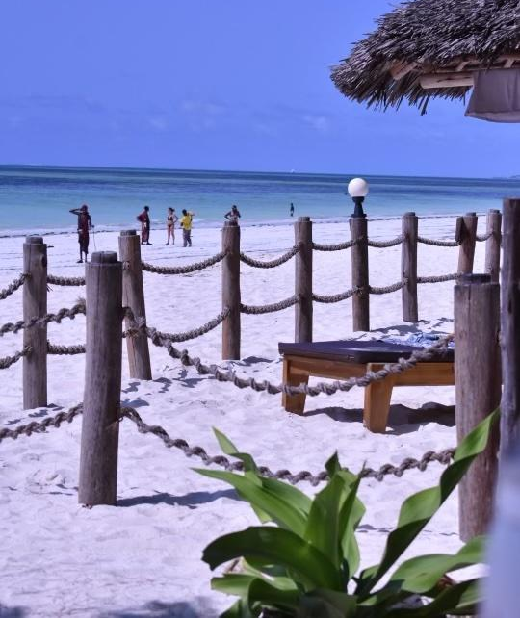
Different groups of people hold varying perspectives and narratives on the government’s role.
Notes:
Some of the issues that we found from our ethnographic interviews and observation that lead us to role of local governance.
Need for cooperation between locally appointed Sheha, the government, and all of the different community stakeholders in Paje
Just like anywhere…
while one local business owner thought expat investors and hotel owners were bribing the government with money, a later interview with an expat hotel owner revealed that they, in turn, felt immense financial pressure from the government and had to persevere to keep their business alive.

Slide 7
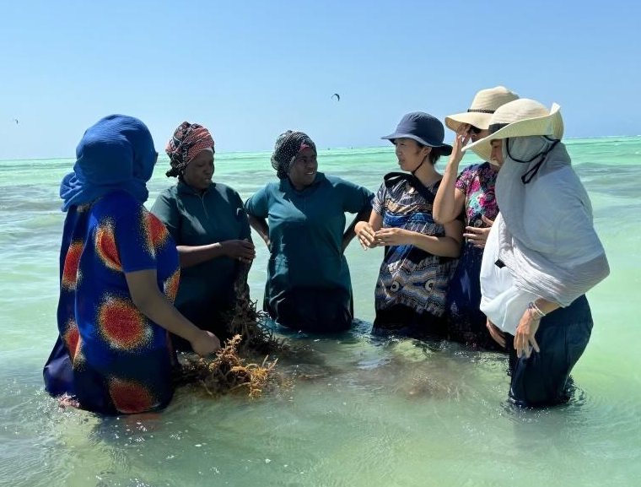
Spatial disputes between seaweed farmers and foreign hotel owners go unresolved.
Notes:
A female seaweed farmer reported that in November of 2022, ice-ice, a climate change-related disease that kills seaweed (Hashim, 2016), forced the farmers to move their plots north. The hotel owners, who had been using the northern beachfront for kitesurfing, offered to pay the women to move their farms back south without understanding the issue of ice-ice, and therefore the women refused the money. The following morning, when the women went out to their farms they saw that they had been destroyed. They contacted the village chairmen who brought the issue to the government, but there was not enough evidence to discover the culprits. The villagers still believe that the hotel owners were responsible.

Slide 8
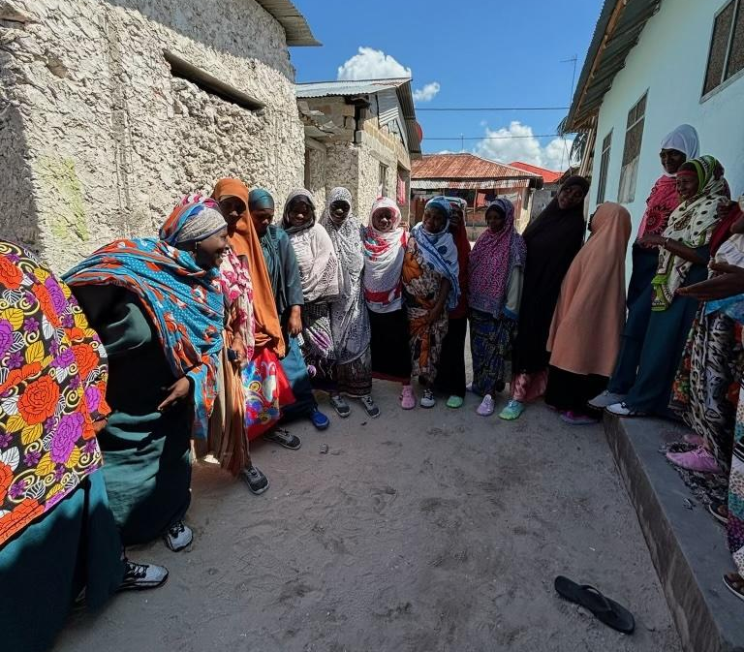
Tourists (often unintentionally) disrespect local customs.
Notes:
During an interview with another female seaweed farmer, two tourists approached her farm wanting to take pictures. One was wearing a bikini, and the other was wearing swim trunks without a shirt. After sternly telling them not to take pictures and leave her be, the farmer explained that she usually welcomes tourists to visit her farm. She believes that any form of awareness for seaweed farming is beneficial, and she enjoys teaching others about her work. However, tourists need to be respectful of local customs and wear clothing that provides sufficient coverage. It is very disrespectful and makes the women uncomfortable when people approach in swimsuits, and it happens very often. From the tourist perspective, they likely have no idea why the seaweed farmers turn them away.

Slide 9
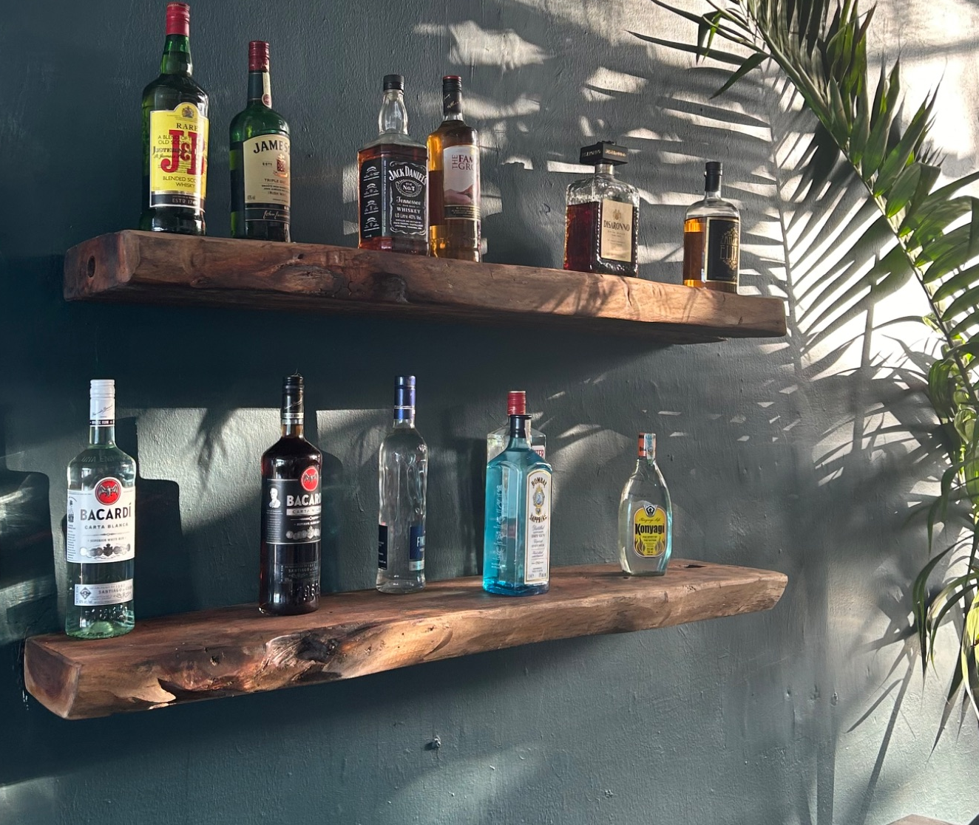
As the foreign presence grows in Zanzibar, morals and values are thought to decay.
Notes:
A retired seaweed farmer explained that the changes in the community in Paje are because “people are not loving each other anymore.” As tourism and the foreign presence grew in Paje, she explained that there has been “moral decay.” Now, everyone has “bad habits” and communities are losing their collectivist values. She is especially concerned about the younger generation who are proliferating these bad habits, but she says that they try to “teach them [the tradition] but they do not hear and they do not understand.”

Slide 10
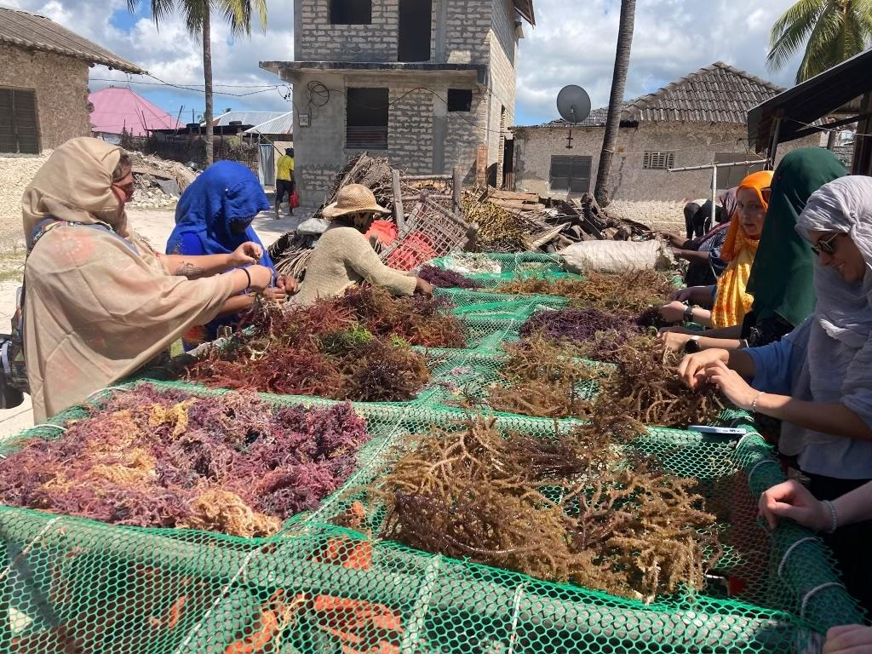
Kindness is powerful in easing relations between different groups.
Notes:
A manager at a foreign-owned hotel stated that in their experience, the local government has been willing to listen to their concerns and help them operate their business because they approached with kindness and openness. They thought that if they started off being upset or angry, the government would have been less willing to work with them, and most of the other foreigners do not know this.

Slide 11
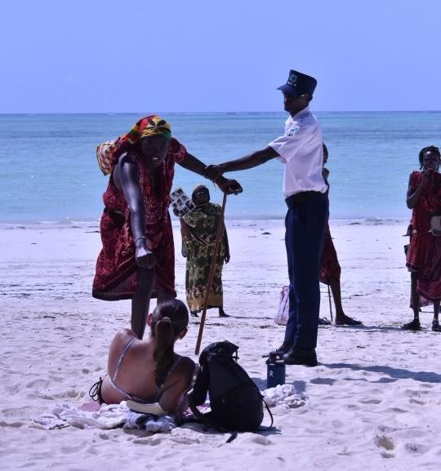
While many community members occupy the same physical space, separation and stereotyping prevails.
Notes:
Many of these issues boil down to barriers in communication across different stakeholders and cultures, which limits effectiveness of blue economy policy why?

Slide 12
3
Policy Recommendations & Intended Outcomes
Notes:
Mia

Slide 13
Creating regional Blue Economy Ministry councils would create a neutral and productive line of communication between the Ministry and all stakeholders.
Opportunities: Enables bottom-up communication as well as top-down communication. Raises awareness of Blue Economy policies. Formalizes a platform for discussion. Generates understanding between community members. Lessens the government’s workload.
Challenges: Different educational backgrounds can result in power dynamics. Capitalizing on meeting time for productivity.
Notes:
Building off of what already exists in terms of governance
Hindsight wish we had pulled an example of how this can work
How much can we talk about power dynamics?

Slide 14
Key feature 1: A non-community member from the Blue Economy Ministry who can serve as a neutral mediator.
Opportunities: Provides a way for the Blue Economy Ministry to be present in a local setting and build rapport with community members.
Challenges: Choosing someone who is neutral and able to mediate. Determining the leadership structure (could be one person, or two or three).

Slide 15
Key feature 2: Councils should be made up of competent representatives from relevant stakeholder groups.
Opportunities: Helps to unify all stakeholders to work towards a common vision of progress and prosperity in Zanzibar.
Challenges: The lack of unification among certain represented groups may make electing representatives difficult. Ensuring the construction of a shared vision to work towards together. Creating space for all represented groups to voice their concerns.

Slide 16
Key feature 3: Councils should set their own goals and activities beyond the main function of conflict resolution.
Opportunities: Having a mechanism for communication across stakeholders for the co-creation and spread of educational modules.
Challenges: Organizational challenges such as delegating tasks and creating a hierarchy of topics to address. Dividing time and resources to accomplish other necessary activities.

Slide 17
Intended Outcomes
Intercultural communication/bridging
Resolving conflicts at a local level
Strengthening community capacity
Raising local understanding of Blue Economy Ministry policies and perspectives
Intergenerational communication and understanding

Slide 18
Asante Sana!
Notes:
We think strengthening existing local governance structures will really help to implement the Blue Economy Ministry policies and ensure they’re successful in the face of the challenges we saw playing out. We would like to sincerely thank you for welcoming us to Zanzibar and for listening to our presentations. We greatly admire the work of the Blue Economy Ministry and look forward to witnessing the impact you continue to make. Asante sana for your time, and please let us know of any questions you have.

