Slide 1
Escape the roundabout: A data-driven path to partnerships
Moderator: Cynthia Curtis, Senior Vice President, Sustainability Stakeholder Engagement, JLL
Mark J. Ohringer, Executive Vice President, Global General Counsel and Corporate Secretary, JLL

Slide 2



Escape the Roundabout:
  A Data-driven path to
  partnerships
    Aleen Bayard
    Cynthia Curtis
    Mark Ohringer
    2018 BCCCC Conference

Slide 3


Setting the stage:
The Sound of Sustainability

Slide 4



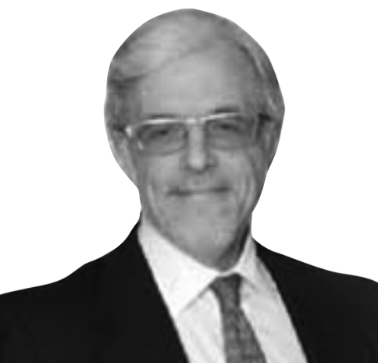
Introductions
“We’re creating green jobs for lawyers
by environmentalists suing us.”
Notes:
Cynthia and Mark to introduce themselves and note the somewhat novel relationship you’ve developed between the GC and Sustainability team. You can reference that I’ll be facilitating the exercises I will be seated near the front v. in the front.

Slide 5


What is your primary role?
Go to www.menti.com
and use the code 33 25 13
Notes:
After the set up, we’ll do the Mentimeter to get a sense of who is in the room.

Slide 6


Lead and learn session overview
    Lessons learned from the front lines
    CSR Integration Audit
    JLL findings from recent studies
    Ethics Bingo
    Ideation Best Practices
Notes:
Cynthia to set up the session

Slide 7
How closely do you work with your colleagues in the following departments?
 | Real estate or facilities | Engineering | Legal | Total
Rarely | 43.75% | 31.25% | 25.00% | 16
 | 7 | 5 | 4
Never | 22.22% | 77.78% | 0.00% | 9
 | 2 | 7 | 0
Sometimes | 27.78% | 27.78% | 44.44% | 18
 | 5 | 5 | 8
Often | 21.05% | 10.53% | 68.42% | 19
 | 4 | 2 | 13
Our pre-survey findings
Notes:
We share the survey results here to establish some context. This slide is animated.

Slide 8
Please indicate which data your sustainability team reviews
in the development of your internal or external reporting. Select all that apply
Answer choices | Responses
Employee engagement | 86.96% | 20
Employee retention | 47.83% | 11
Employee absenteeism | 17.39% | 4
Compliance or ethics data | 56.52% | 13
Sexual harassment of other types of workplace discrimination claims | 21.74% | 5

Slide 9
How closely do you work with colleagues in
other functions?
Go to www.menti.com
and use the code 33 25 13
Notes:
After the set up, we’ll do the Mentimeter to get a sense of who is in the room.

Slide 10

Our vision….
Notes:
Driving CR is

Slide 11
CSR Integration audit
 | Excellent – 5 | Strong – 4 | Growing – 3 | Weak – 2 | Non-existent – 1
MarCom
HR
Legal / Compliance
Real estate
Engineering
EHS
Investor Relations
Scores
Notes:
This will be the first exercise. We will need a handout for the participants to complete the exercise.
28-35: Best practices shared with their table Did anyone score more than 28
If you scored on any function a 4 or 5: share a best practice
What had a relationship jump from 1 to 3
How have you leveraged the 4s and 5s
Report out single idea
Handout a Resource Sheet i.e. SHRM, SRI, IFMA, BOMA

Slide 12
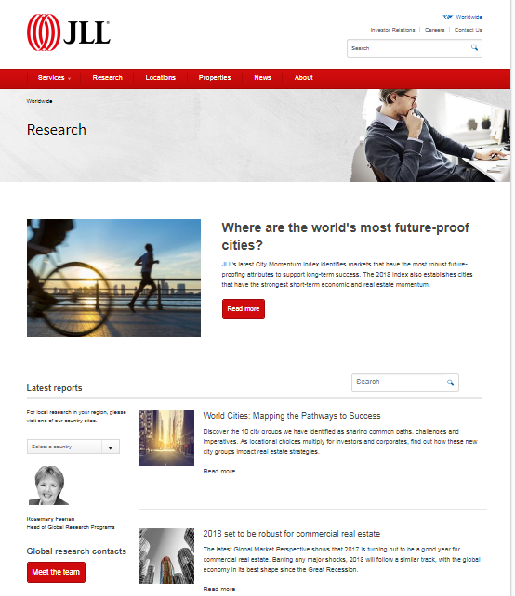
Are you leveraging data to forge internal partnerships?
Go to www.menti.com
and use the code 33 25 13
Notes:
After the set up, we’ll do the Mentimeter to get a sense of who is in the room.

Slide 13

Research = + Relationships
    JLL’s experience and thought leadership related to office design supports:
    Workplace productivity
    Employee engagement
    Ethics and governance
    Green office ROI.
    Which provides opportunities to partner with colleagues in:
    Facilities / real estate
    Engineering
    HR
    Legal
    IR.
Notes:
Here we introduce our hypothesis: Our survey and the live audience poll highlights there are stronger and weaker ties among colleagues. JLL has compelling data to help make the case with those colleagues that CR is everybody’s business. In particular, with three orphaned functions: Real Estate, HR and IR. And Legal to some extent. The rest of our presentation presents highlights of our data that they can use to share with their non-CR colleagues.

Slide 14


Does your office environment drive engagement, empowerment and fulfillment?

Slide 15
Real estate impact on productivity
Shareholder value
Business agility
Access to best talent
Changing nature
of work
Ethics lapses cost
Transforming Work | Optimizing Place | Enhancing Experience | Promoting Integrity
Notes:
Macro look at topic #1: real estate impacts productivity. Productivity is of keen interest to the C Suite. So as sustainability professionals, we want to be aware of this “arena” of potential value-add. In particular, enhancing experience (and therefore engagement) and integrity are the points we are reinforcing for the BCCCC crowd.

Slide 16
New realities impacting workplace
85% of Fortune’s Best Companies to Work For allow employees to telecommute or work from home at least 20% of the time.
- Fortune Magazine
76% of corporate real estate
executives face high expectations around the improvement of workplace productivity
- JLL
In 2015, Millennials
(born 1980 - 1997) became the largest generation in the workforce.
- U.S. Census
The average knowledge worker is at their desk only 40% of the time.
- Gartner Group
By 2020, 65 million Americans will be temps, freelancers, and independent contractors (40% of the workforce)
- Forbes
Individual work has decreased from approximately 40% of all work accomplished in 2000, to
20% today.
- Intuit
Notes:
Big picture data re: workplace trends and related topics we are covering re: engagement and productivity.

Slide 17

Workplace productivity
Cost / Space Reduction
Workplace
Technology
Workplace Experience
Change Management
76% of corporate real estate executives say they are expected to deliver improved workplace productivity
64% of respondents say that workplace environments
clearly influence the ethical environment
88%
82%
76%
75%
Sources: JLL, Global Corporate Real Estate Trends, 2015; and Joint study by JLL and Ethisphere on the “Influence of Workplace Design and Practices on the Ethical Environment”, 2011
Notes:
This data relates to both productivity and ethics so maybe Mark delivers it.

Slide 18
Office activities are disconnected from value
Employees waste time on email, and neglect thinking and brainstorming
Lost Productivity
due to abuse
Time Spent
Value Created
Missed
opportunities
Source: JLL “Forget the Workplace for Now”

Slide 19
Workplaces can enhance employee experiences
Fostering a creative environment through creative spaces leads to
improved productivity
Brainstorming
leads to idea generation
Use writable surfaces around the office to enable small groups to collaborate on ideas and solutions
Thinking
leads to creative solutions
Introduce “quiet” zones to help people think and focus without distractions
Talking
leads to collaboration
Create hubs at natural gathering points to promote informal interactions
Interacting
leads to diversity
Create spaces to realize the full benefit of diverse backgrounds and thinking
Source: JLL “Forget the Workplace for Now”

Slide 20
Better experience translates to better-engaged employees
Worldwide, actively disengaged employees outnumber engaged employees by nearly 2-1
Actively disengaged
Not engaged
Engaged
Source: Gallup. “How Employee Engagement Drives Growth”.
Notes:
Wellness focuses on the physical aspects of health, e.g., blood pressure clinics, exercise, etc.
Wellbeing takes a more holistic view, acknowledging the connection between body and mind, the workplace environment and experience
Mindfulness is the ability to train the mind to focus
Activity-based work is not just the ‘where’, but the ‘what’ and ‘how’ of work
Ethics and integrity refer to the ways employees treat each other and their employer, with a view toward maximizing respectfulness and diversity while minimizing ethics and legal lapses from fraud, conflicts of interest, and abuse of the internet
Engaged employees are defined by the consistent discretionary effort and integrity they bring to their work

Slide 21

More engaged employees translates to more profits
Studies have shown that companies perform better with a higher level of employee engagement
increase in
profitability
increase in
productivity
Source: Gallup. “How Employee Engagement Drives Growth”.

Slide 22

Option
More engaged employees translates to more profits
Studies have shown that companies perform better with a higher level of employee engagement
increase in
profitability
increase in
productivity
Source: Gallup. “How Employee Engagement Drives Growth”.

Slide 23

Wellness and wellbeing
Next big thing: health and wellbeing
Well certification complements green standards such as Leed with new requirements
Light
Water
Comfort
Nourishment
Fitness
Air
Mind

Slide 24

How are you collaborating with HR to initiate and leverage this kind of data?

Slide 25


They can also promote transparent and ethical cultures
Open workspaces may reduce employee misconduct
    In a survey of more than 200 companies, 64% reported no
    visible ethics violations over
    a two-year period, which they attributed to moving to an open
    floor plan
    81 percent believe that open
    office plans, which cause staff
    to be more visible to one another, generally promote improved behaviors when compared to individual office plans
    Most employees consider
    trust and kindness – which
    can be fostered through agile workspace - the biggest positive impact on their engagement at work.
“Employees are more aware of openness and sharing in the office, and are less likely
to commit ethics violations as a result.”
Sources: Joint study by JLL and Ethisphere on the “Influence of Workplace Design and Practice on the Ethical Environment , 2011; and JLL Workplace Study, June 22, 2017
Notes:
Survey methodology:
The survey was conducted from November 2010 to February 2011. More than 200 responses were collected using a web-based survey tool. All respondents received the same question set.
While the majority of respondents came from U.S.-based organizations, the data collected represents a diverse pool of organizations with regard to operational industry, workforce size and annual revenues.

Slide 26
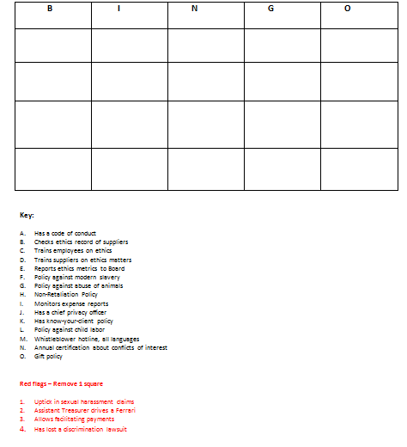
Ethics Bingo
Notes:
We will need input from Mark on certain types of items i.e. Codes of Conduct, Training, Industry Standards, Ecovadis, Hotlines, Supply chain
Bingo game.

Slide 27
Wrapping up
What is one practical idea you can immediately apply when you return to your office?
Which function has the most upside potential in terms of forging stronger relationships to support corporate citizenship?
Where could additional data help strengthen your case for resources, visibility and impact either inside or outside the organization?

Slide 28
Additional resources
JLL: http://www.jll.com/research
SHRM: Society for Human Resource Management
IFMA: International Facility Management Association
BOMA: Building Owners & Managers Association
Ethisphere
Law Firm Sustainability Network

